Slide 1

CAP615 PROGRAMMING IN JAVA
Lecture #3

Slide 2
Today’s topics
Introduction to Java : basic java concepts:
Introduction about the java programming development tools,
Java keywords,
variables,
data types,
operators and
control statements

Slide 3
Control Statements:
???

Slide 4
if/else constructs
If(condition)
{
// statement execute when condition true
}
else
{
// statement execute when condition false
}

Slide 5
switch statement
To select choices/options from user it used:
Switch with choice (integer value like: 1,2,..)
Switch with choice (character value like: A,B,..)
Switch with choice (String value like: “ADD”,”SUB”,..)

Slide 6
looping controls, nested loops
While loop
Do while loop
For loop
Enhanced or advanced for loop
Nested loops means one loop inside another loop.

Slide 7
Enhanced For loop
for(data_type variable : array | collection)
{
//body of for-each loop
}

Slide 8
Example:
int myArray[]=new int[]{11,12,13,14,15};
for(int num : myArray)
{
System.out.println(num);
}

Slide 9
Does Java support goto?
No

Slide 10
inner and nested classes
Define a class within another class, such classes are known as nested classes
Nested classes are divided into two categories:
static nested class :
Nested classes that are declared static are called static nested classes.
inner class :
An inner class is a non-static nested class.

Slide 11
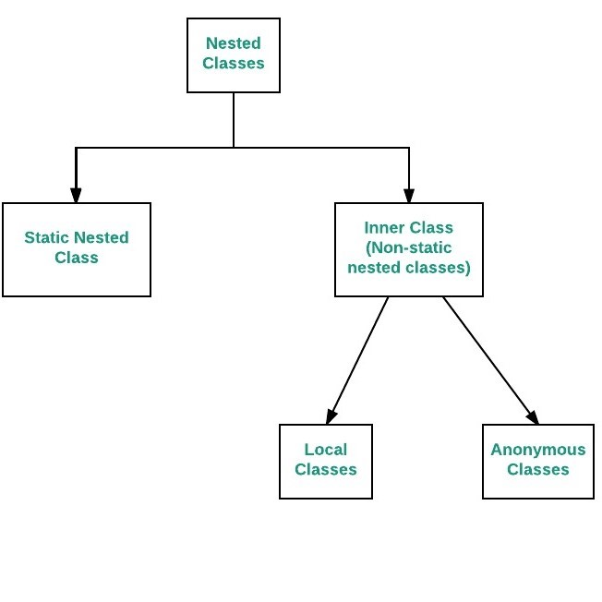

Slide 12
class Outer{
static class inner
{
public void getData()
{
int myArray[]=new int[]{11,12,13,14,15};
for(int num:myArray)
{
System.out.println(num);
}
}
}
}
public class Main
{
public static void main(String[] args)
{
Outer.inner in=new Outer.inner();
in.getData();
}
}

Slide 13
What will be output?
static class Outer{
class inner
{
public void getData()
{
int myArray[]=new int[]{11,12,13,14,15};
for(int num:myArray)
{
System.out.println(num);
}
}
}
}
public class Main
{
public static void main(String[] args)
{
Outer.inner in=new Outer.inner();
in.getData();
}
}

Slide 14
Difference between Normal inner class and Static nested class
In normal inner class, we cannot declare any static members but in the static nested class, we can declare a static member including the main method.
Since we cannot declare the main method in the normal inner class, therefore, we cannot run inner class directly from the command prompt. But we can declare the main method and can also run the static nested class directly from the command prompt.
A normal inner class can access both static and non-static members of the outer class directly but from the static nested class, we can access only static members.

Slide 15


